Slide 1

Big Adaptive Rotor (BAR) Project
Inflatable Blade Structural Analysis
Author: Roland Feil
Source: https://www.ge.com/reports/size-matters-next-big-thing-wind-turbines/

Slide 2
Content
Concept Introduction
Optimization Setup
Blade Structural Analysis
Baseline blade
Baseline blade with Kevlar skin
Baseline blade with Kevlar skin and Kevlar as primary elliptically shaped structure
Baseline blade with Kevlar skin and glass UD as primary elliptically shaped structure
Baseline blade with Kevlar skin and Carbon as primary elliptically shaped structure
Summary & Comparison
Material Properties
Summary & Conclusions
Outlook & Ongoing Work
Appendix

Slide 3
Concept Introduction
by Nicole Mendoza

Slide 4
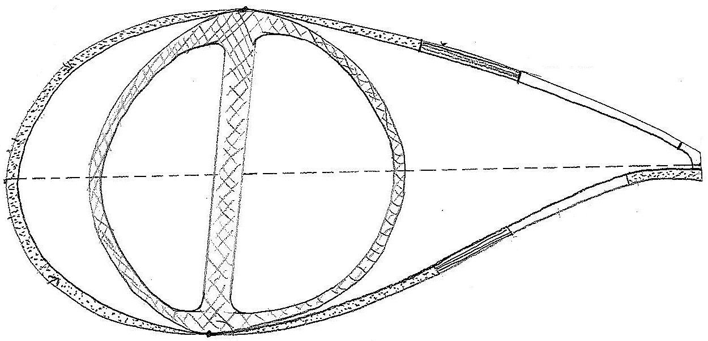
The Inflatable Blade Concept
Materials
Kevlar – reliable (military, re-entry grade), non-conducting (lightening), flame resistant (seams and thread done same as parachutes)
Teflon – protects Kevlar from UV, mitigates icing and soiling, white (soaked)
Foam – lightweight, rigid → maintains aerodynamic shape
Uniaxial CF – provides strength for buckling
foam-filled section
(hard, rigid)
pre-made pultruded uniaxial CF pre-inserted into pocket
exterior Kevlar only
soaked with Teflon
design can support both rounded and sharp SSTE
traditionally-constructed
primary structure (box beam, double web, etc.)
PSTE must be rigid (foam)
to attach TE devices
air-filled sections allow for shape control &
pneumatic actuation (can also sew in air tubes)
*** could have spanwise compartments to pneumatically actuate to stall! ***
Aero shell created with 2 layers of Kevlar with filler in between
pre-sewn compartment structure
Legend
Foam filler
Uniaxial CF
Air

Slide 5
The Inflatable Blade Concept
Factory
Fabric/textile manufacturing executed in parallel with primary structure manufacturing (traditional), then joined during curing phase, then shipped
Transportation
Transport by train, deflated and attached (smaller in chord, lighter)
On-site Manufacturing
Inflate mandrels
Inject foam → let harden
Deflate & remove mandrels
Glue on LEP, passive aero devices
Smooth/putty over injection ports (no need to paint blade)
could insert mandrels here
foam-filled section
(hard, rigid)
pre-made pultruded uniaxial CF pre-inserted into pocket
exterior Kevlar only
soaked with Teflon
design can support both rounded and sharp SSTE
traditionally-constructed
primary structure (box beam, double web, etc.)
PSTE must be rigid (foam)
to attach TE devices
air-filled sections allow for shape control &
pneumatic actuation (can also sew in air tubes)
*** could have spanwise compartments to pneumatically actuate to stall! ***
Aero shell created with 2 layers of Kevlar with filler in between
pre-sewn compartment structure
Legend
Foam filler
Uniaxial CF
Air

Slide 6
The Inflatable Blade Concept
foam-filled section
(hard, rigid)
pre-made pultruded uniaxial CF pre-inserted into pocket
exterior Kevlar only
soaked with Teflon
design can support both rounded and sharp SSTE
traditionally-constructed
primary structure (box beam, double web, etc.)
PSTE must be rigid (foam)
to attach TE devices
air-filled sections allow for shape control &
pneumatic actuation (can also sew in air tubes)
*** could have spanwise compartments to pneumatically actuate to stall! ***
Aero shell created with 2 layers of Kevlar with filler in between
pre-sewn compartment structure
Features
Re-usable primary structure facilitates derivative blade products (within 2 aero-structural constraints)
Air-filled compartments yield pneumatic aero shape control (airfoil shape and pitch/stall control)
No pressurized air (unless have pneumatically actuated compartments), so won't “burst” under extreme conditions
Compartmental design can easily be segmented/compartmentalized spanwise and chordwise via sewing seams – any size, any #
This concept does not consider structural spanwise segmenting (joints) → other BAR task
Legend
Foam filler
Uniaxial CF
Air

Slide 7
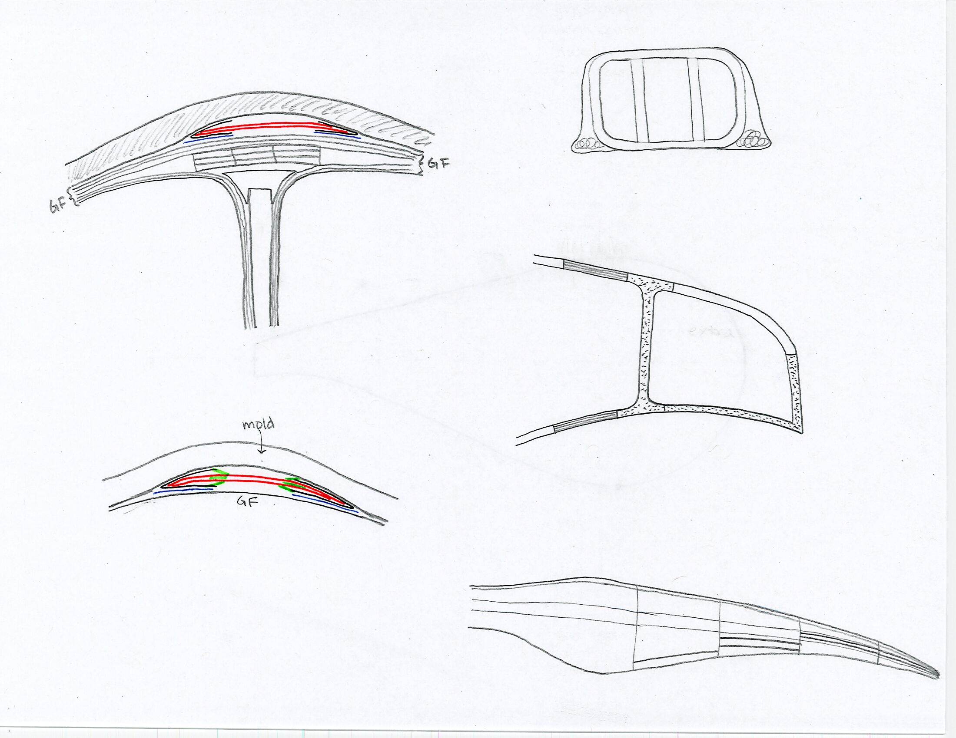
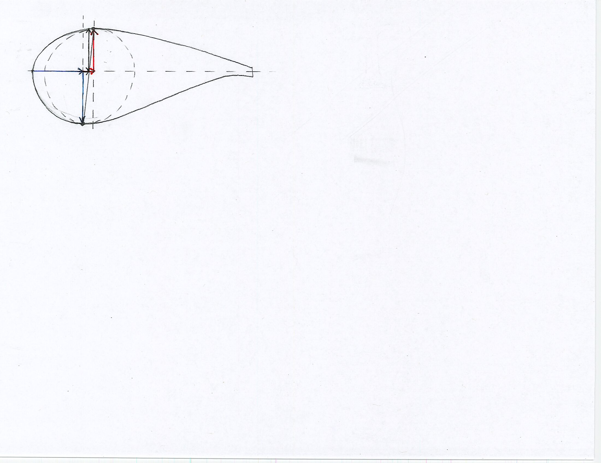
The Inflatable Blade Concept
Attachment Mechanism (Shell to Structure)
Include 2 Kevlar layers (minimum) in top and bottom of primary structure inside mold @ SS/PS max thk pos before curing
- would need new molds anyways (smaller, lighter)
Cure primary structure + Kevlar layers, remove from molds
Sew/join Kevlar shell to dry Kevlar on primary structure
Design supports both traditional and filament-wound primary structures
Aft Panel Spar Caps / Side Beam
Designs fully supports addition with no restrictions
Simply create compartment and fill with rigid foam
Will need another mandrel for internal aft section
mold
CF spar cap/beam
shear web
Aero-Structure Coupling
Reusability of primary structure to create derivative blades is subject to two design restrictions/constraints
Airfoil families (geometry)
Blade absolute thickness spanwise distribution
Most likely structure will constrain aero (will have some wiggle room)
Peel Ply
Vacuum Bag
Kevlar
Tacky Tape
PS max thk pos & value
SS max thk pos & value
Airfoil max thk pos & value
Note: Drawings NOT TO SCALE
Example of Chordwise and Spanwise Compartmentalization

Slide 8
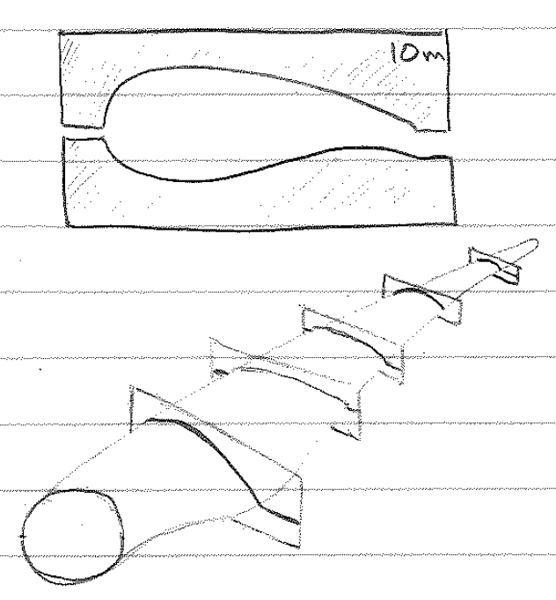
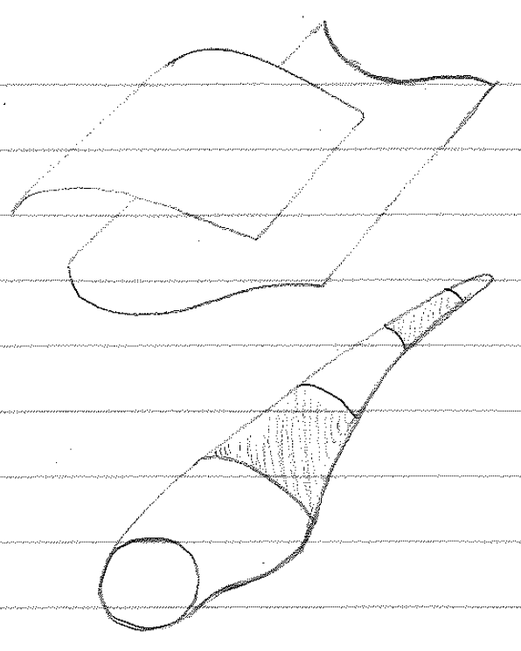
The Inflatable Blade Concept
Exterior Shape Control
Option # 1 Option # 2 Option # 3
Station Templates Traditional Mold 3D-Printed Segments
Price: $ (or less)
Can be made in parallel to or before blade manufacturing (laser cut)
Easily storable (low space required)
Recyclable
Any # along span (20-25?)
Split @ LE, TE mold release lines
Least/smallest amount of shape control
Most likely wood or recycled plastic
On-site usage (easily transported)
Interchangeable for new blades
Price: $$
Create traditional mold using standard methods
Need to transport to site (large, lighter)
Make prior to blade manufacturing
Must have injection ports
Most/highest amount of shape control
Not reusable/recyclable
Split @ LE, TE mold release lines
Need supporting equipment (cranes, etc.)
?
Price: ? = OPEX (segments) + CAPEX (machine)
Any # of variably-sized spanwise blade segments → variable amount of shape control
Depends on University of Maine printer: 30m X 6.7m X 3m (L X W X H)
Easily segmentable and transportable
Use recyclable materials (wood cellulose and/or recycled plastic)
Split @ LE, TE mold release lines
Can be made in parallel to or before blade manufacturing

Slide 9
Optimization Setup

Slide 10
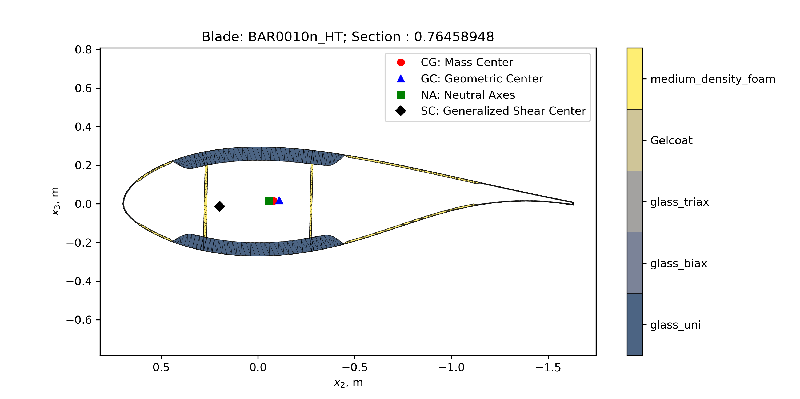
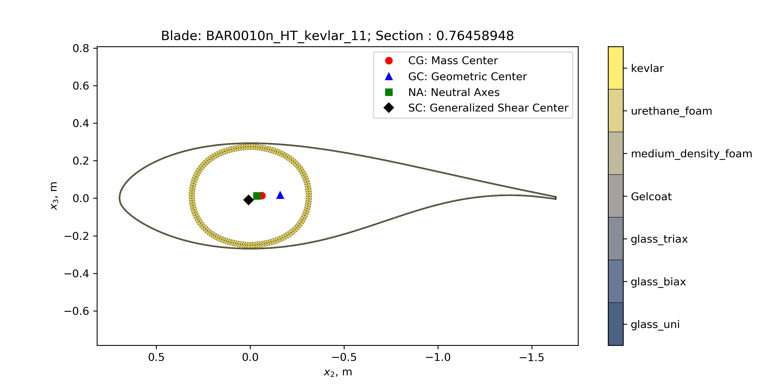
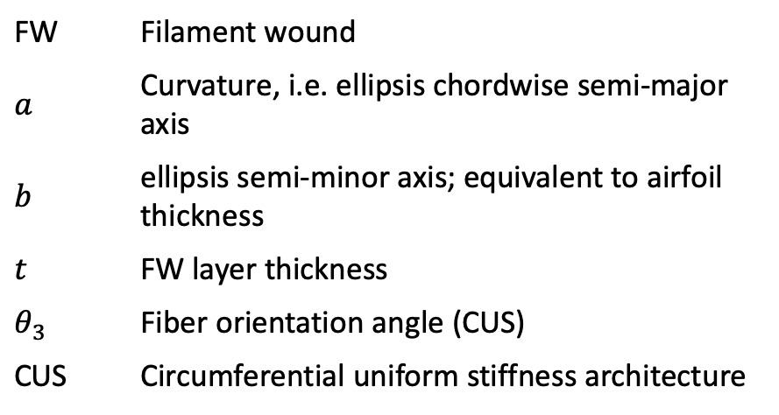
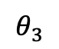
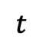
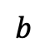
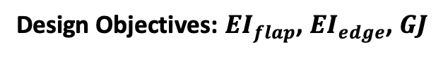
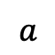
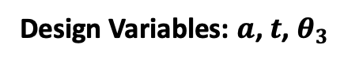
Optimization Setup
BAR0010 Baseline
Inflatable blade concept
$$t$$
$$θ_{3}$$
$$a$$
$$b$$
Chosen radial station for initial studies: r/R = 0.76458948
FFA-W3-241 airfoil
Determine baseline stiffness properties at blade cross section
FW | Filament wound
$$a$$ | Curvature, i.e. ellipsis chordwise semi-major axis
$$b$$ | ellipsis semi-minor axis; equivalent to airfoil thickness
$$t$$ | FW layer thickness
$$θ_{3}$$ | Fiber orientation angle (CUS)
CUS | Circumferential uniform stiffness architecture
Design Objectives: ${EI}_{flap}$, ${EI}_{edge}$, $GJ$
Design Variables: $a$, $t$, $θ_{3}$

Slide 11
Blade Structural Analysis

Slide 12
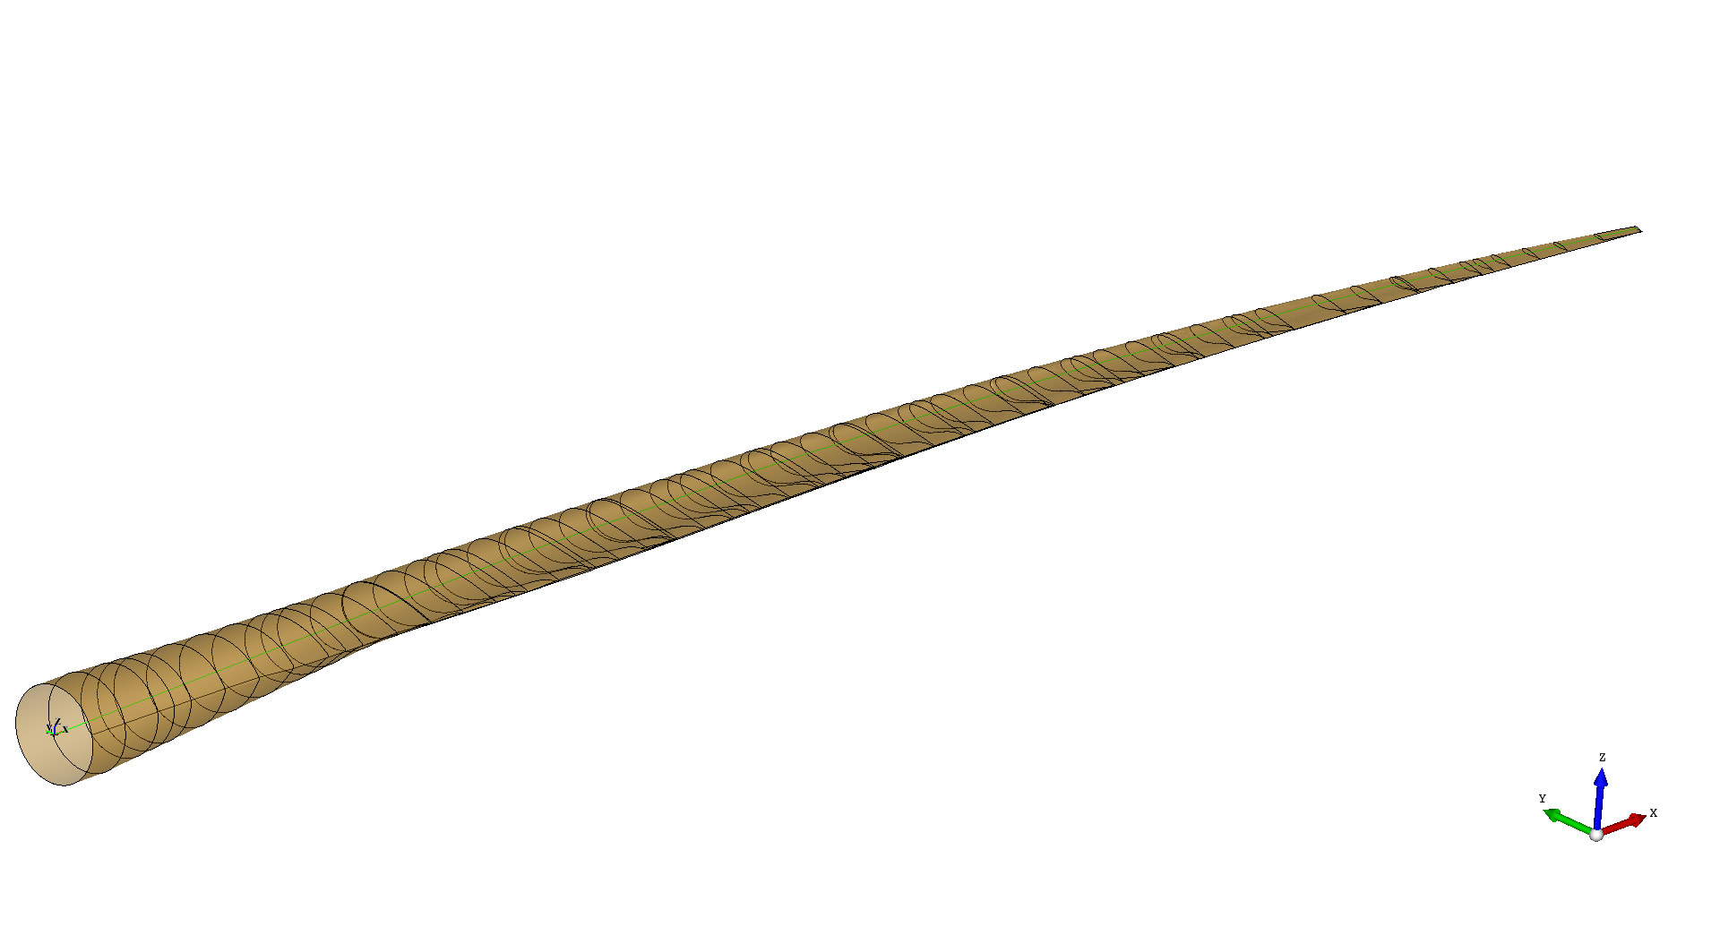
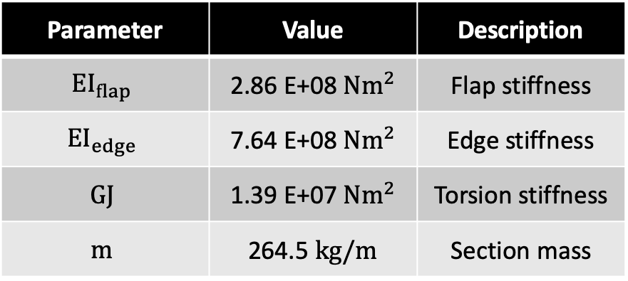
Inflatable Blade Structural Analysis – Baseline #00
BAR baseline blade:
Currently using BAR0010 for robustness and stable design
Will convert to slender blade BAR01** once it is available
BAR0010 blade section parameters:
24% thick airfoil @ 76.5% span
Primarily glass and foam
Parameter | Value | Description
$${EI}_{flap}$$ | 2.86 E+08 $Nm^{2}$ | Flap stiffness
$${EI}_{edge}$$ | 7.64 E+08 $Nm^{2}$ | Edge stiffness
$$GJ$$ | 1.39 E+07 $Nm^{2}$ | Torsion stiffness
$$m$$ | 264.5 $kg/m$ | Section mass

Slide 13
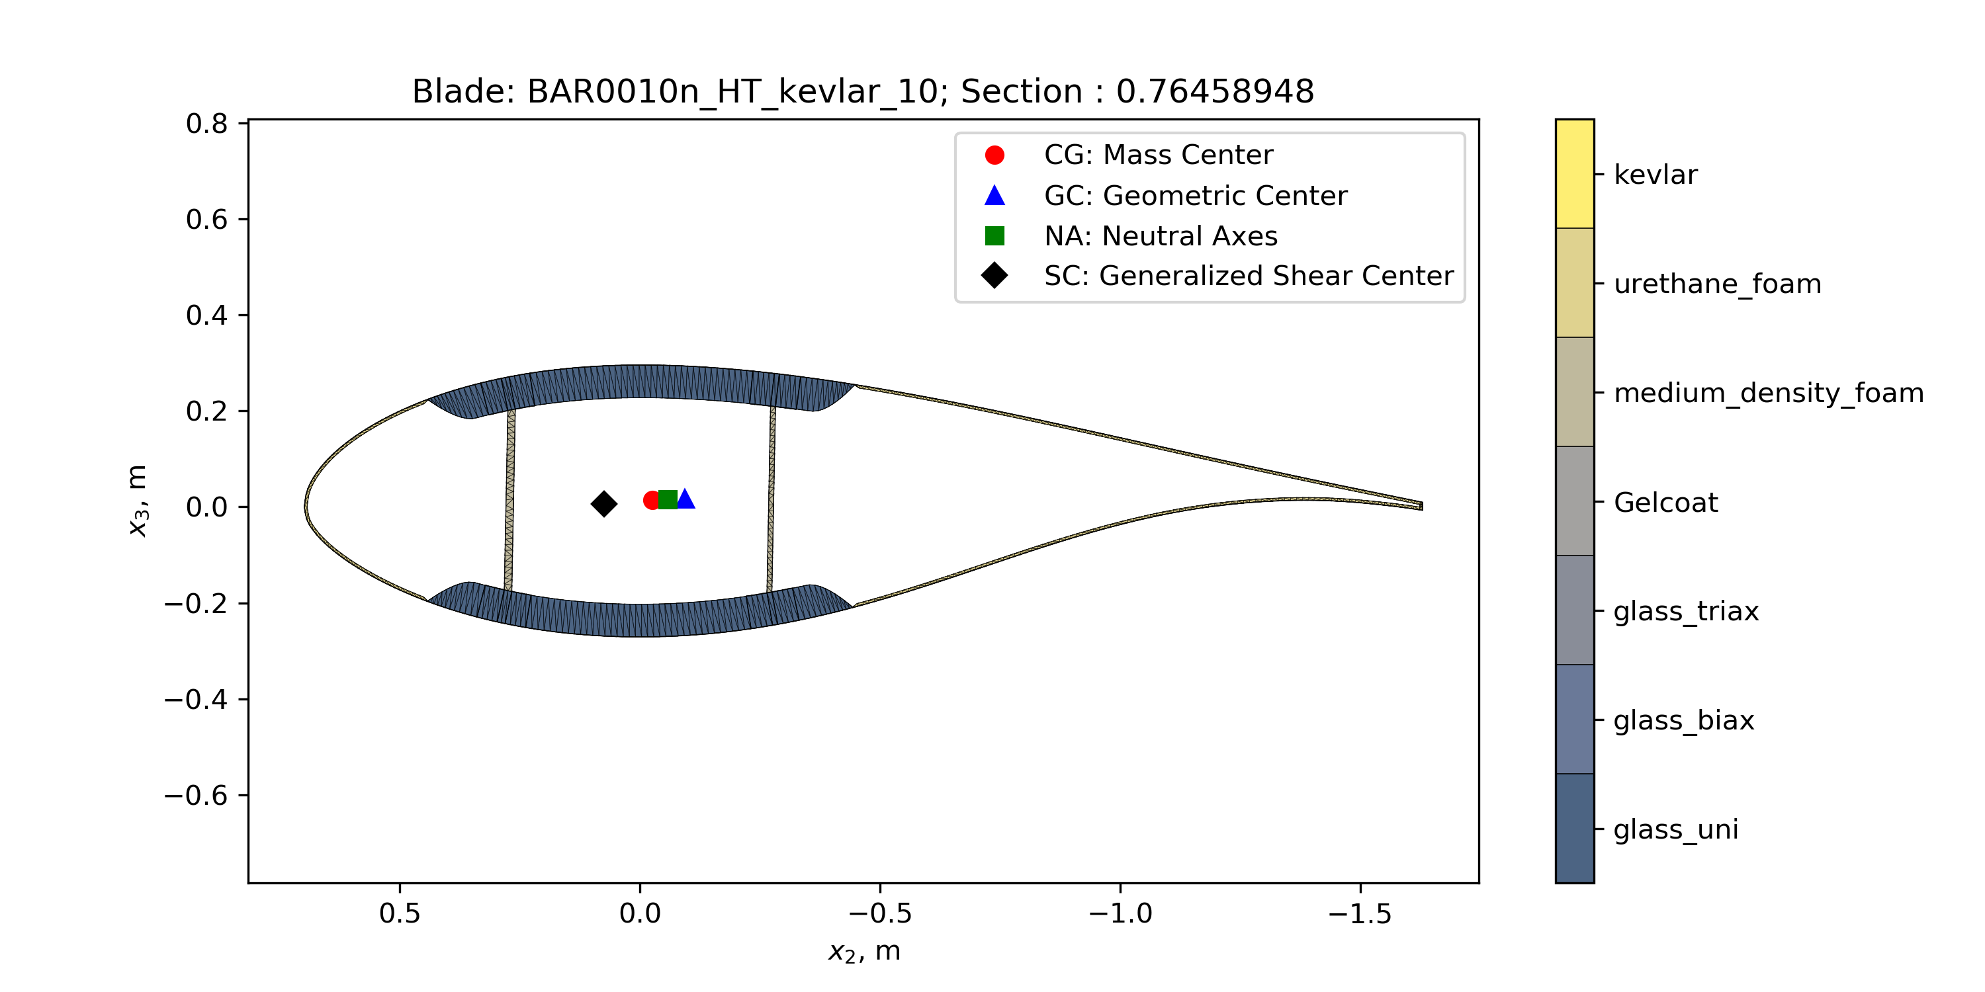
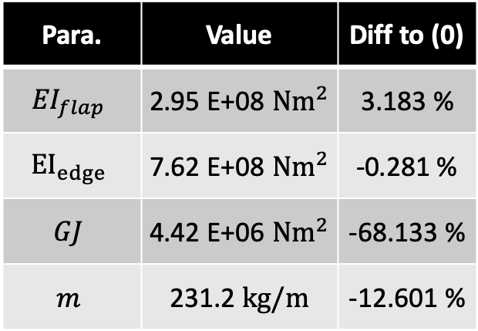
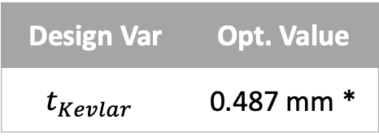
Inflatable Blade Structural Analysis – Kevlar Skin #10
Optimized shell only, kept identical beams and webs
Removed LE & TE reinforcements
Glass skin adapted to → Kevlar medium density foam → injectable foam (thickness = 0.5 mm)
Design Var | Opt. Value
$$t_{Kevlar }$$ | 0.487 mm *
*Value for each the outer and the inner skin layer
Para. | Value | Diff to (0)
$${EI}_{flap}$$ | 2.95 E+08 $Nm^{2}$ | 3.183 %
$${EI}_{edge}$$ | 7.62 E+08 $Nm^{2}$ | -0.281 %
$$GJ$$ | 4.42 E+06 $Nm^{2}$ | -68.133 %
$$m$$ | 231.2 $kg/m$ | -12.601 %

Slide 14

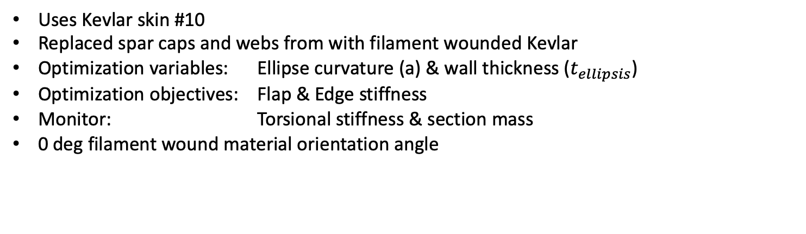
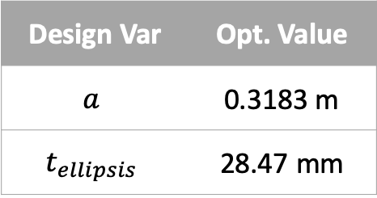
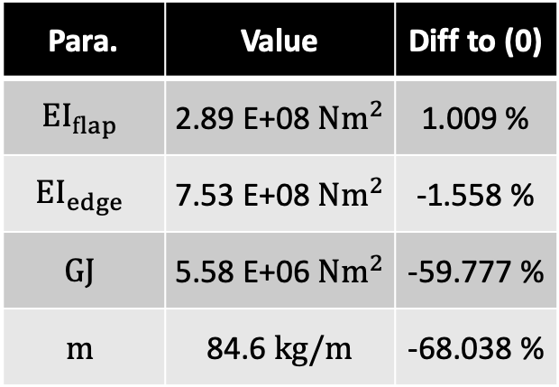
Inflatable Blade Structural Analysis – Kevlar #11a
Uses Kevlar skin #10
Replaced spar caps and webs from with filament wounded Kevlar
Optimization variables: Ellipse curvature (a) & wall thickness ($t_{ellipsis}$)
Optimization objectives: Flap & Edge stiffness
Monitor: Torsional stiffness & section mass
0 deg filament wound material orientation angle
Design Var | Opt. Value
$$a$$ | 0.3183 m
$$t_{ellipsis}$$ | 28.47 mm
Para. | Value | Diff to (0)
$${EI}_{flap}$$ | 2.89 E+08 $Nm^{2}$ | 1.009 %
$${EI}_{edge}$$ | 7.53 E+08 $Nm^{2}$ | -1.558 %
$$GJ$$ | 5.58 E+06 $Nm^{2}$ | -59.777 %
$$m$$ | 84.6 $kg/m$ | -68.038 %

Slide 15
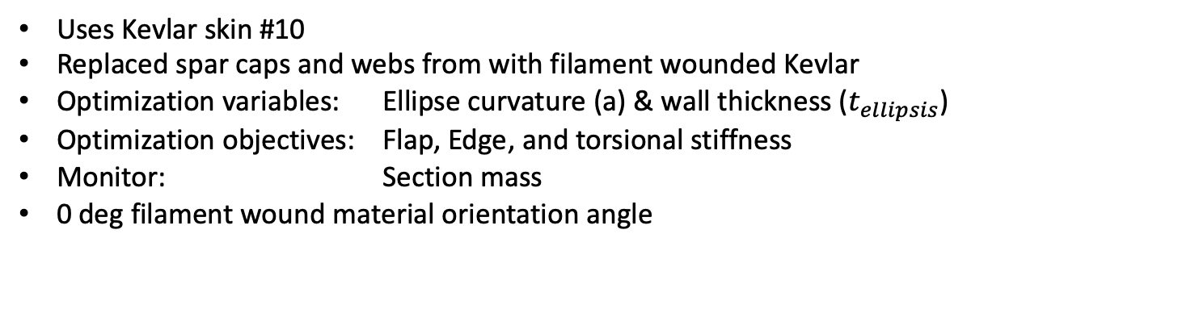

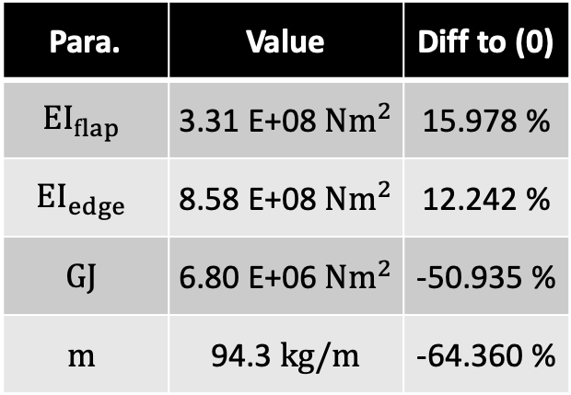
Inflatable Blade Structural Analysis – Kevlar #11b
Uses Kevlar skin #10
Replaced spar caps and webs from with filament wounded Kevlar
Optimization variables: Ellipse curvature (a) & wall thickness ($t_{ellipsis}$)
Optimization objectives: Flap, Edge, and torsional stiffness
Monitor: Section mass
0 deg filament wound material orientation angle
Design Var | Opt. Value
$$a$$ | 0.3611 m
$$t_{ellipsis}$$ | 30.31 mm
Para. | Value | Diff to (0)
$${EI}_{flap}$$ | 3.31 E+08 $Nm^{2}$ | 15.978 %
$${EI}_{edge}$$ | 8.58 E+08 $Nm^{2}$ | 12.242 %
$$GJ$$ | 6.80 E+06 $Nm^{2}$ | -50.935 %
$$m$$ | 94.3 $kg/m$ | -64.360 %

Slide 16

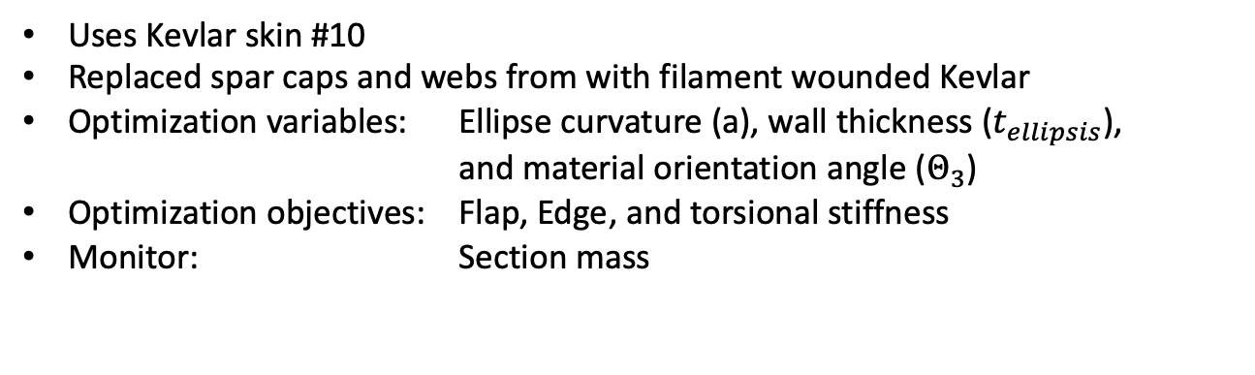
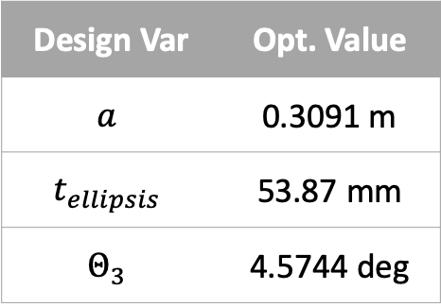
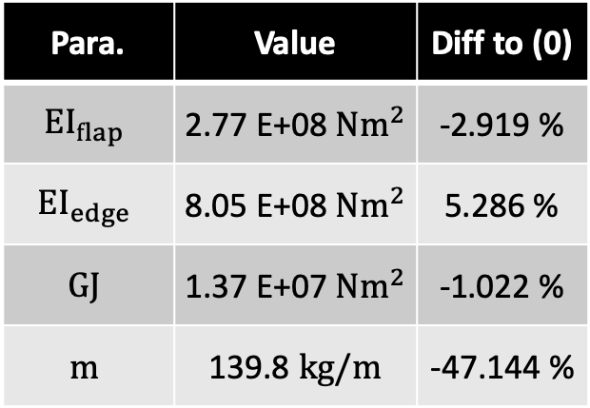
Inflatable Blade Structural Analysis – Kevlar #11c
Uses Kevlar skin #10
Replaced spar caps and webs from with filament wounded Kevlar
Optimization variables: Ellipse curvature (a), wall thickness ($t_{ellipsis}$), and material orientation angle ($Θ_{3}$)
Optimization objectives: Flap, Edge, and torsional stiffness
Monitor: Section mass
Design Var | Opt. Value
$$a$$ | 0.3091 m
$$t_{ellipsis}$$ | 53.87 mm
$$Θ_{3}$$ | 4.5744 deg
Para. | Value | Diff to (0)
$${EI}_{flap}$$ | 2.77 E+08 $Nm^{2}$ | -2.919 %
$${EI}_{edge}$$ | 8.05 E+08 $Nm^{2}$ | 5.286 %
$$GJ$$ | 1.37 E+07 $Nm^{2}$ | -1.022 %
$$m$$ | 139.8 $kg/m$ | -47.144 %

Slide 17
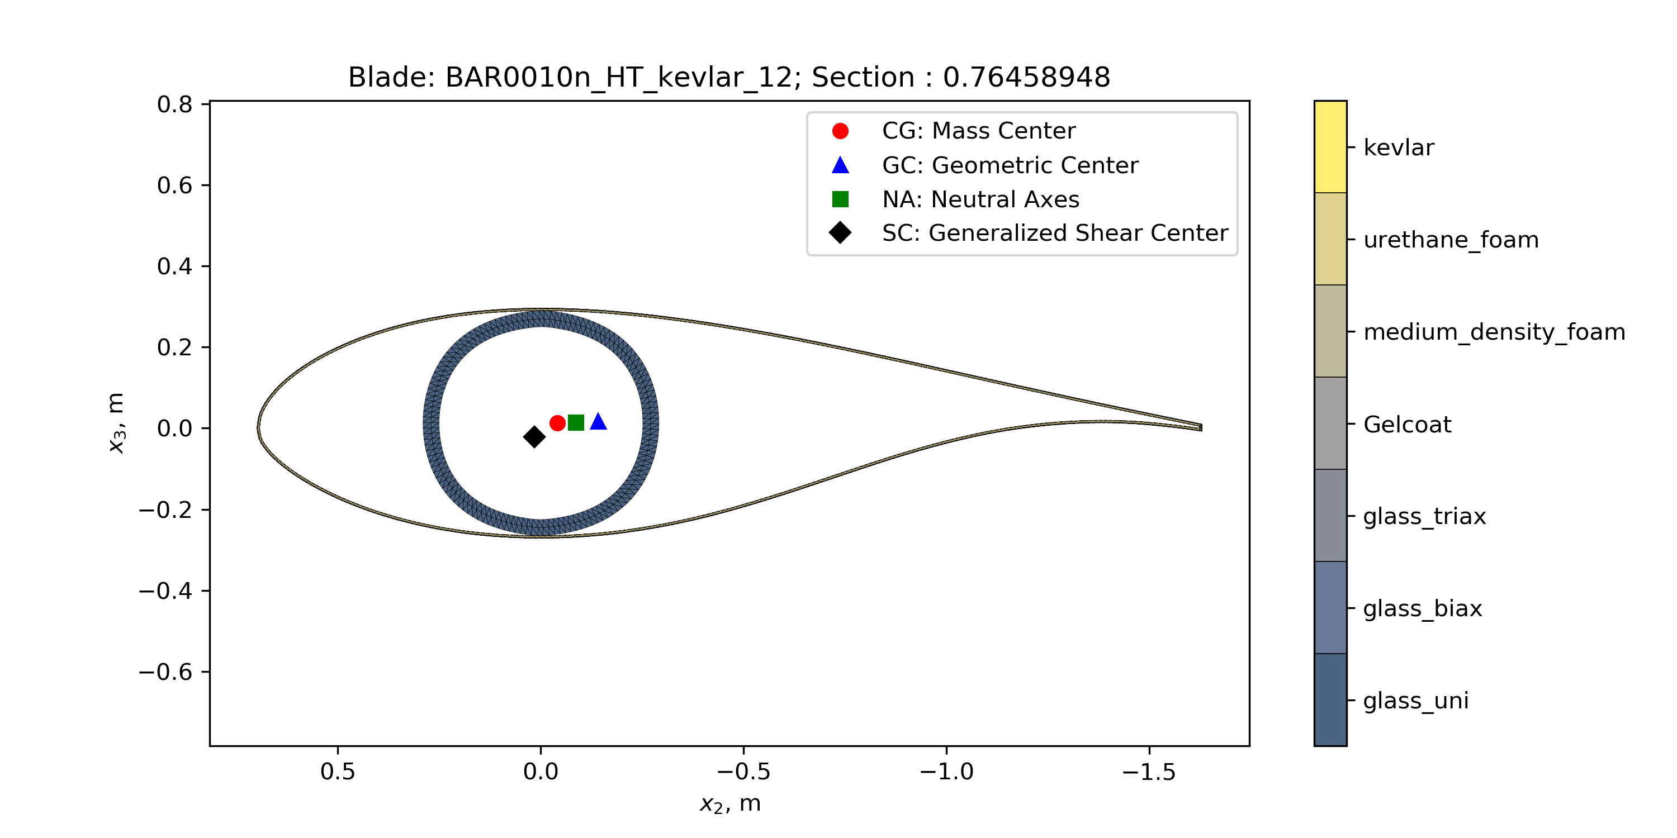
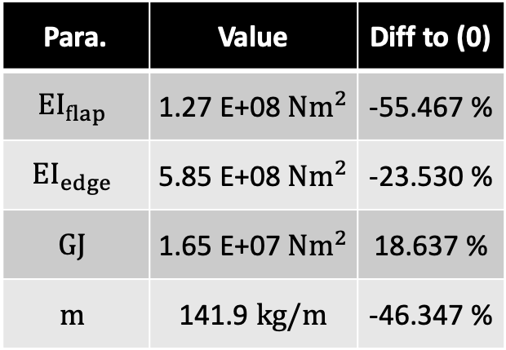
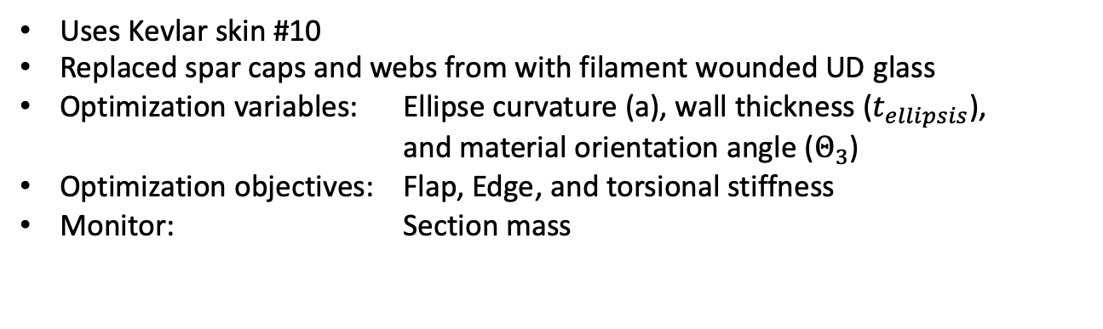

Inflatable Blade Structural Analysis – Glass Uni #12a
Uses Kevlar skin #10
Replaced spar caps and webs from with filament wounded UD glass
Optimization variables: Ellipse curvature (a), wall thickness ($t_{ellipsis}$), and material orientation angle ($Θ_{3}$)
Optimization objectives: Flap, Edge, and torsional stiffness
Monitor: Section mass
Design Var | Opt. Value
$$a$$ | 0.3197 m
$$t_{ellipsis}$$ | 39.58 mm
$$Θ_{3}$$ | 0.2302 deg
Para. | Value | Diff to (0)
$${EI}_{flap}$$ | 1.27 E+08 $Nm^{2}$ | -55.467 %
$${EI}_{edge}$$ | 5.85 E+08 $Nm^{2}$ | -23.530 %
$$GJ$$ | 1.65 E+07 $Nm^{2}$ | 18.637 %
$$m$$ | 141.9 $kg/m$ | -46.347 %

Slide 18
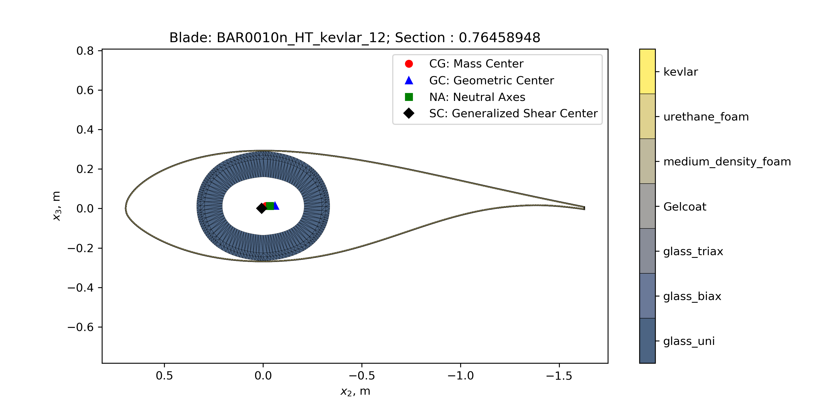

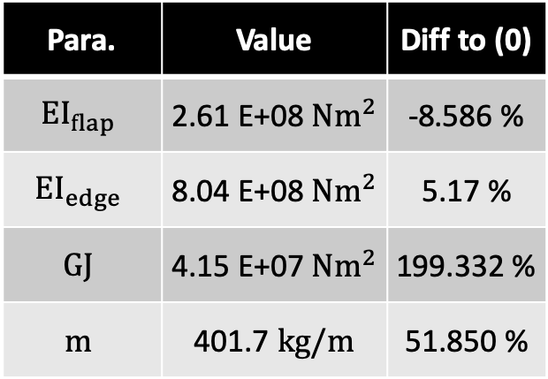
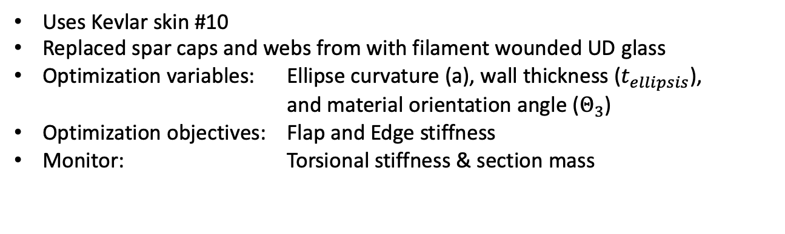
Inflatable Blade Structural Analysis – Glass UD #12b
Uses Kevlar skin #10
Replaced spar caps and webs from with filament wounded UD glass
Optimization variables: Ellipse curvature (a), wall thickness ($t_{ellipsis}$), and material orientation angle ($Θ_{3}$)
Optimization objectives: Flap and Edge stiffness
Monitor: Torsional stiffness & section mass
Design Var | Opt. Value
$$a$$ | 0.373 m
$$t_{ellipsis}$$ | 129.7 mm
$$Θ_{3}$$ | -0.144 deg
Para. | Value | Diff to (0)
$${EI}_{flap}$$ | 2.61 E+08 $Nm^{2}$ | -8.586 %
$${EI}_{edge}$$ | 8.04 E+08 $Nm^{2}$ | 5.17 %
$$GJ$$ | 4.15 E+07 $Nm^{2}$ | 199.332 %
$$m$$ | 401.7 $kg/m$ | 51.850 %

Slide 19
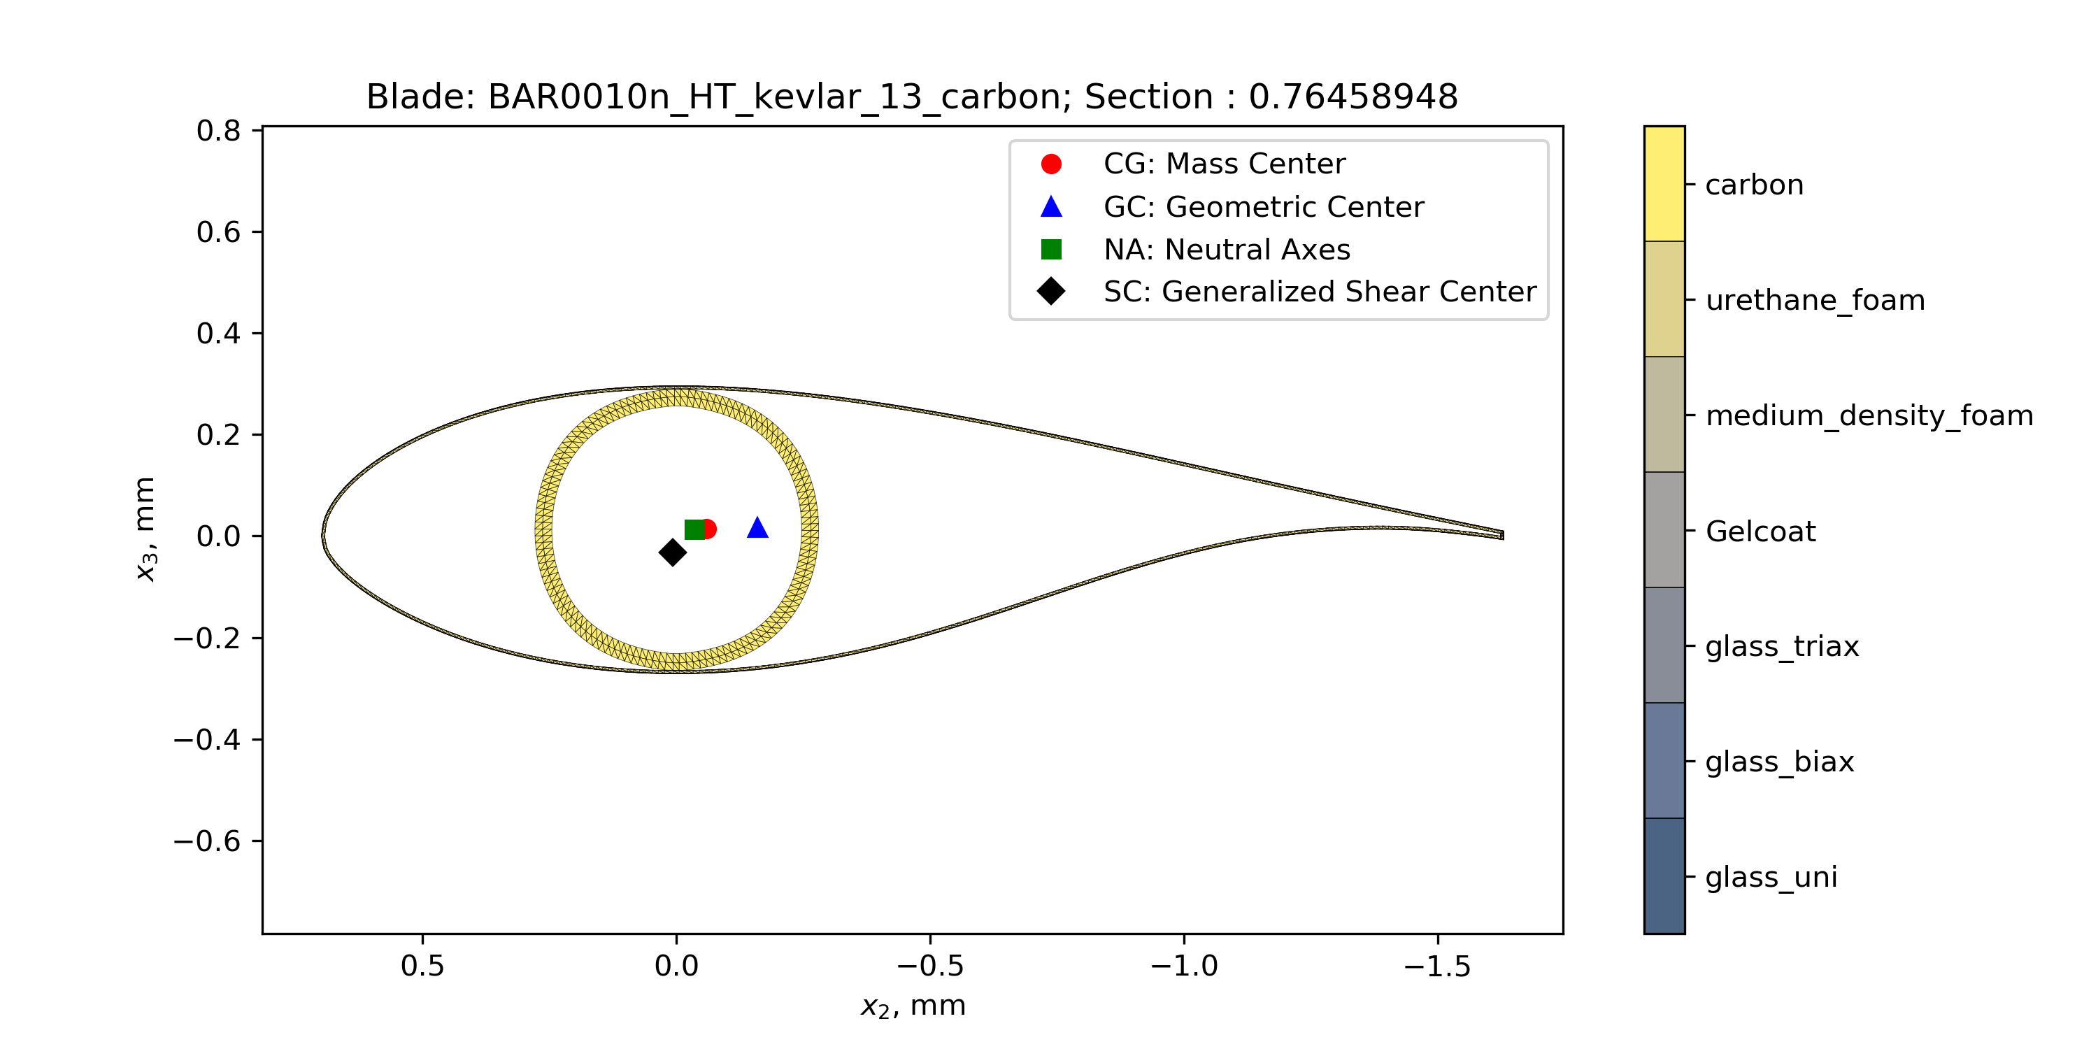
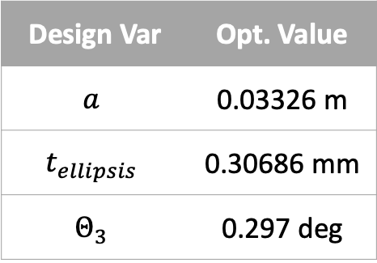
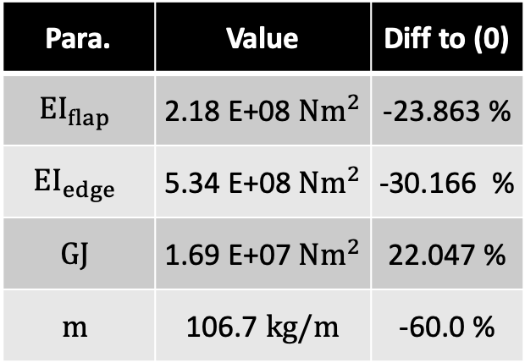
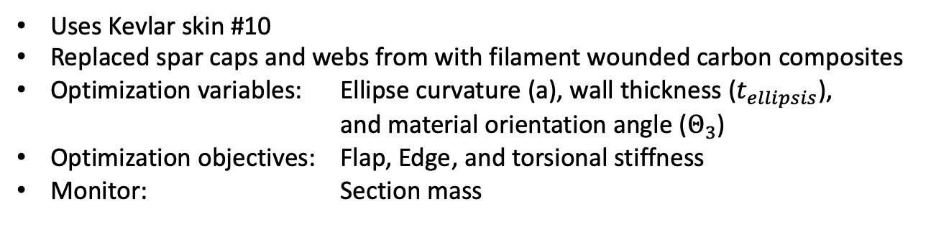
Inflatable Blade Structural Analysis – Carbon #13a
Uses Kevlar skin #10
Replaced spar caps and webs from with filament wounded carbon composites
Optimization variables: Ellipse curvature (a), wall thickness ($t_{ellipsis}$), and material orientation angle ($Θ_{3}$)
Optimization objectives: Flap, Edge, and torsional stiffness
Monitor: Section mass
Design Var | Opt. Value
$$a$$ | 0.03326 m
$$t_{ellipsis}$$ | 0.30686 mm
$$Θ_{3}$$ | 0.297 deg
Para. | Value | Diff to (0)
$${EI}_{flap}$$ | 2.18 E+08 $Nm^{2}$ | -23.863 %
$${EI}_{edge}$$ | 5.34 E+08 $Nm^{2}$ | -30.166 %
$$GJ$$ | 1.69 E+07 $Nm^{2}$ | 22.047 %
$$m$$ | 106.7 $kg/m$ | -60.0 %

Slide 20
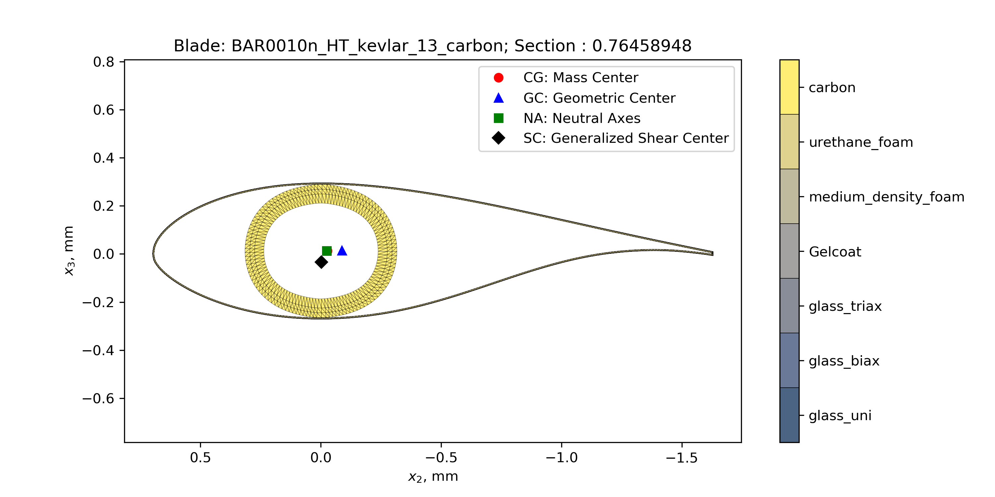

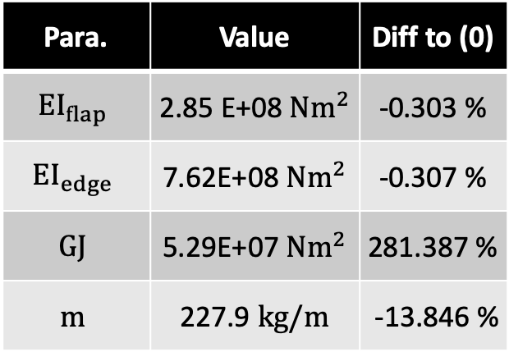
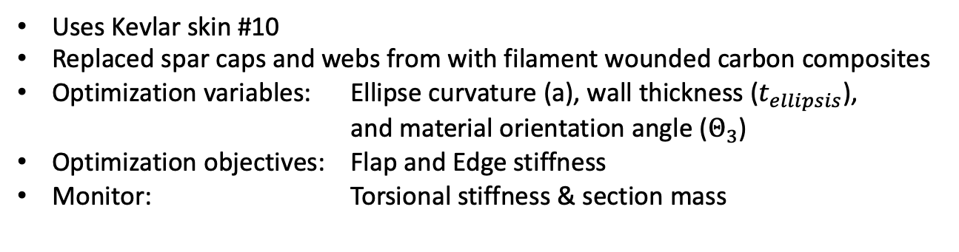
Inflatable Blade Structural Analysis – Carbon #13b
Uses Kevlar skin #10
Replaced spar caps and webs from with filament wounded carbon composites
Optimization variables: Ellipse curvature (a), wall thickness ($t_{ellipsis}$), and material orientation angle ($Θ_{3}$)
Optimization objectives: Flap and Edge stiffness
Monitor: Torsional stiffness & section mass
Design Var | Opt. Value
$$a$$ | 0.07807 m
$$t_{ellipsis}$$ | 0.34812 mm
$$Θ_{3}$$ | -8.8798 deg
Para. | Value | Diff to (0)
$${EI}_{flap}$$ | 2.85 E+08 $Nm^{2}$ | -0.303 %
$${EI}_{edge}$$ | 7.62E+08 $Nm^{2}$ | -0.307 %
$$GJ$$ | 5.29E+07 $Nm^{2}$ | 281.387 %
$$m$$ | 227.9 $kg/m$ | -13.846 %

Slide 21
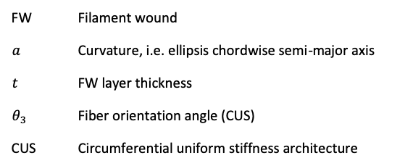
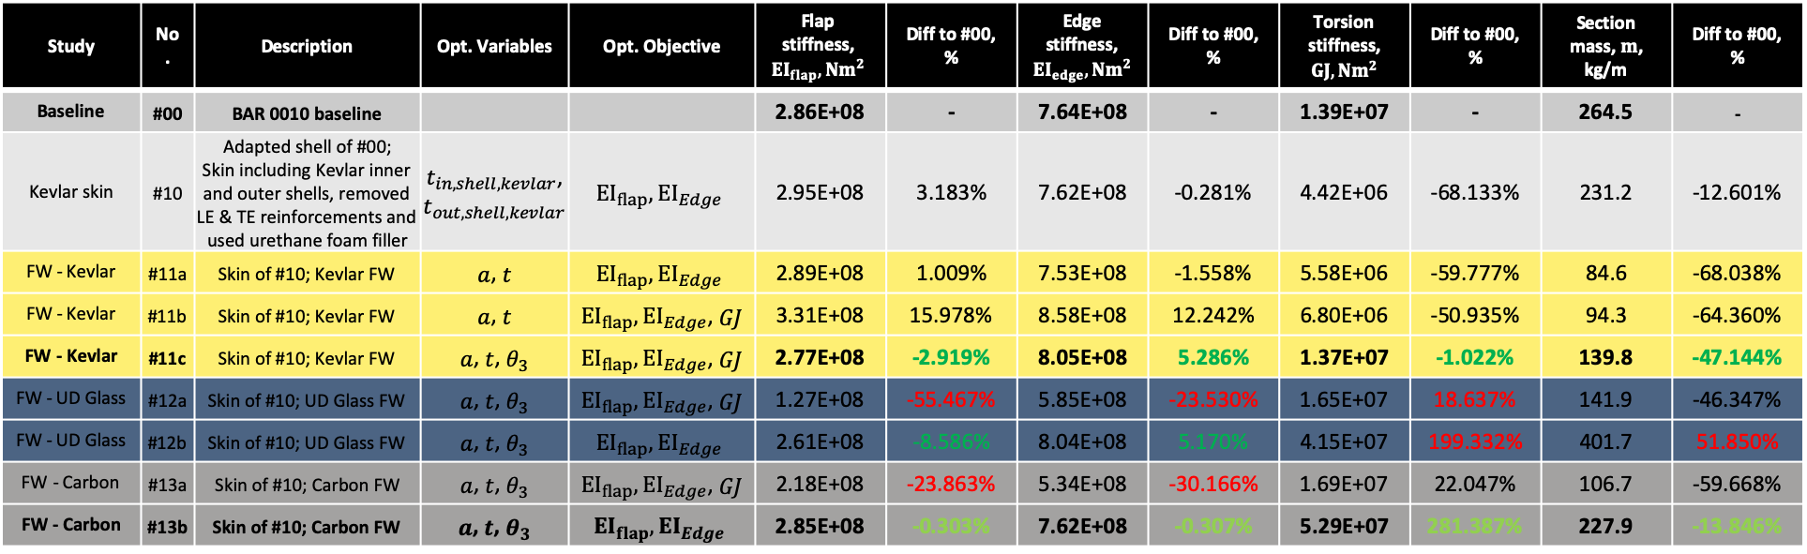
Summary & Comparison at r/R=0.76
Study | No. | Description | Opt. Variables | Opt. Objective | Flap stiffness, $${EI}_{flap}, {Nm}^{2}$$ | Diff to #00, % | Edge stiffness, ${EI}_{edge}, {Nm}^{2}$ | Diff to #00, % | Torsion stiffness, $GJ, {Nm}^{2}$ | Diff to #00, % | Section mass, $m$, kg/m | Diff to #00, %
Baseline | #00 | BAR 0010 baseline |  |  | 2.86E+08 | - | 7.64E+08 | - | 1.39E+07 | - | 264.5 | -
Kevlar skin | #10 | Adapted shell of #00; Skin including Kevlar inner and outer shells, removed LE & TE reinforcements and used urethane foam filler | $t_{in,shell,kevlar}$, $$t_{out,shell,kevlar}$$ | $${EI}_{flap},{EI}_{Edge}$$ | 2.95E+08 | 3.183% | 7.62E+08 | -0.281% | 4.42E+06 | -68.133% | 231.2 | -12.601%
FW - Kevlar | #11a | Skin of #10; Kevlar FW | $a$, $t$ | $${EI}_{flap},{EI}_{Edge}$$ | 2.89E+08 | 1.009% | 7.53E+08 | -1.558% | 5.58E+06 | -59.777% | 84.6 | -68.038%
FW - Kevlar | #11b | Skin of #10; Kevlar FW | $a$, $t$ | ${EI}_{flap},{EI}_{Edge}$, $GJ$ | 3.31E+08 | 15.978% | 8.58E+08 | 12.242% | 6.80E+06 | -50.935% | 94.3 | -64.360%
FW - Kevlar | #11c | Skin of #10; Kevlar FW | $a$, $t$, $θ_{3}$ | ${EI}_{flap},{EI}_{Edge}$, $GJ$ | 2.77E+08 | -2.919% | 8.05E+08 | 5.286% | 1.37E+07 | -1.022% | 139.8 | -47.144%
FW - UD Glass | #12a | Skin of #10; UD Glass FW | $a$, $t$, $θ_{3}$ | ${EI}_{flap},{EI}_{Edge}$, $GJ$ | 1.27E+08 | -55.467% | 5.85E+08 | -23.530% | 1.65E+07 | 18.637% | 141.9 | -46.347%
FW - UD Glass | #12b | Skin of #10; UD Glass FW | $a$, $t$, $θ_{3}$ | $${EI}_{flap},{EI}_{Edge}$$ | 2.61E+08 | -8.586% | 8.04E+08 | 5.170% | 4.15E+07 | 199.332% | 401.7 | 51.850%
FW - Carbon | #13a | Skin of #10; Carbon FW | $a$, $t$, $θ_{3}$ | ${EI}_{flap},{EI}_{Edge}$, $GJ$ | 2.18E+08 | -23.863% | 5.34E+08 | -30.166% | 1.69E+07 | 22.047% | 106.7 | -59.668%
FW - Carbon | #13b | Skin of #10; Carbon FW | $a$, $t$, $θ_{3}$ | $${EI}_{flap},{EI}_{Edge}$$ | 2.85E+08 | -0.303% | 7.62E+08 | -0.307% | 5.29E+07 | 281.387% | 227.9 | -13.846%
FW | Filament wound
$$a$$ | Curvature, i.e. ellipsis chordwise semi-major axis
$$t$$ | FW layer thickness
$$θ_{3}$$ | Fiber orientation angle (CUS)
CUS | Circumferential uniform stiffness architecture
FW Kevlar & FW Carbon look promising !

Slide 22
Material Properties

Slide 23
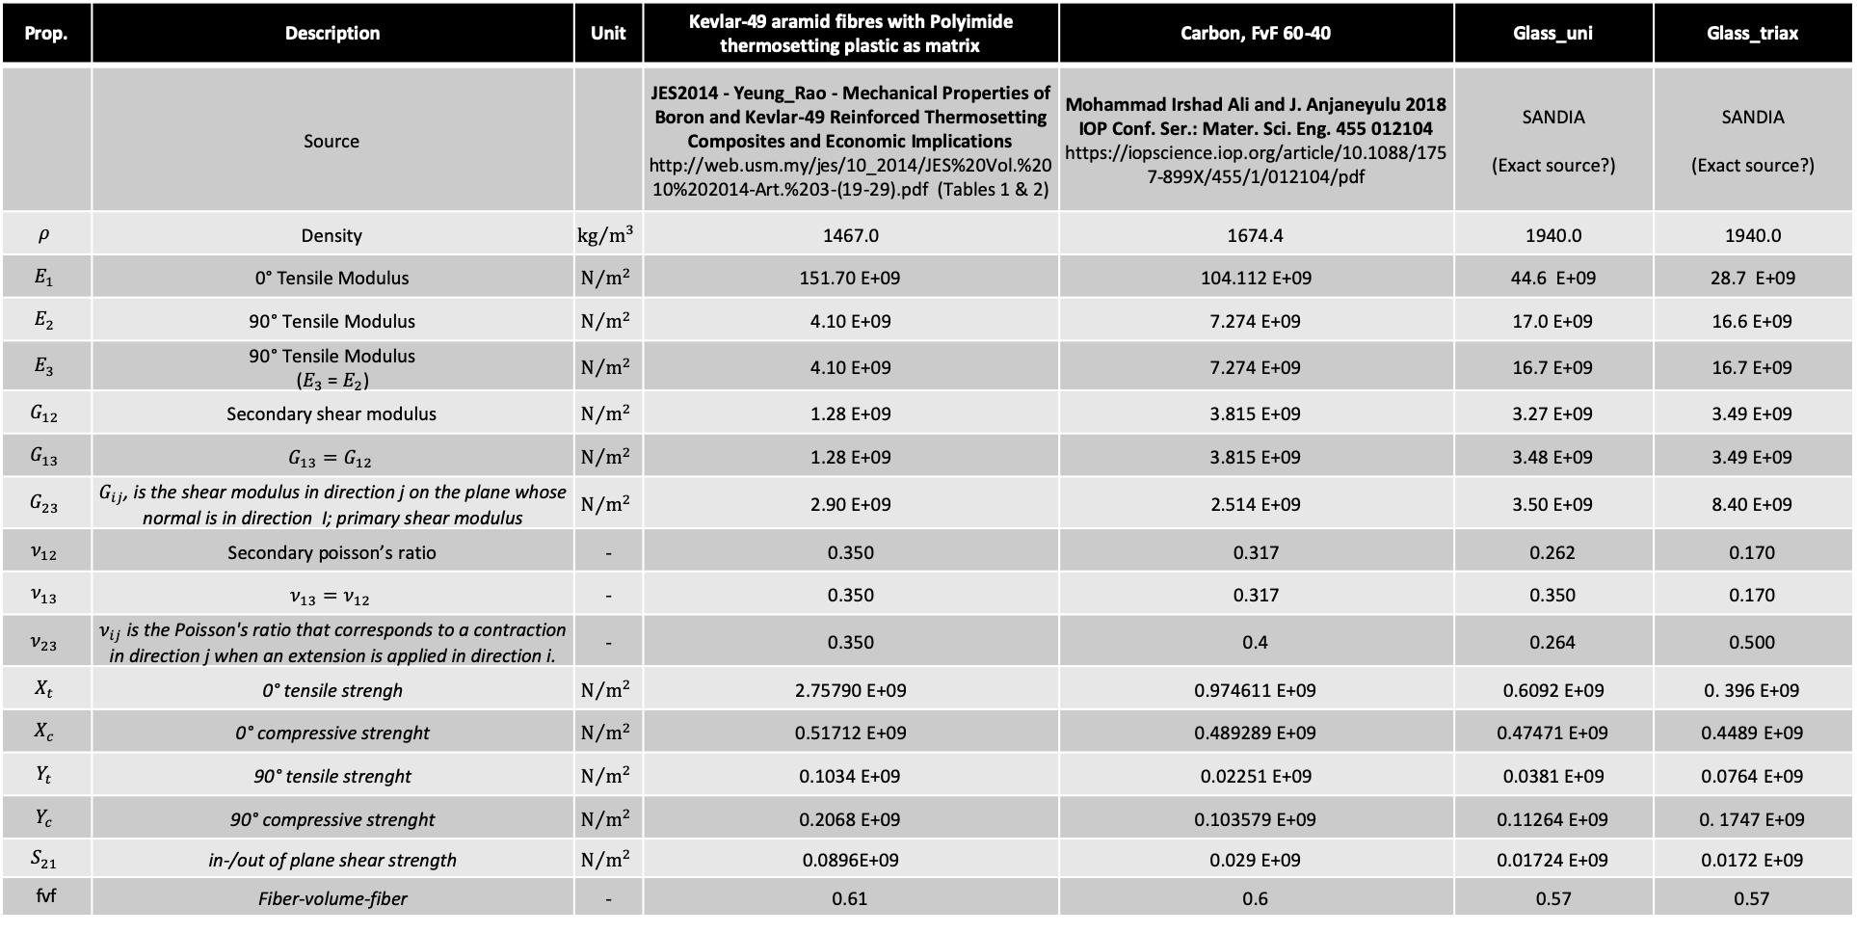
Material Properties
Prop. | Description | Unit | Kevlar-49 aramid fibres with Polyimide thermosetting plastic as matrix | Carbon, FvF 60-40 | Glass_uni | Glass_triax
 | Source |  | JES2014 - Yeung_Rao - Mechanical Properties of Boron and Kevlar-49 Reinforced Thermosetting Composites and Economic Implications http://web.usm.my/jes/10_2014/JES%20Vol.%2010%202014-Art.%203-(19-29).pdf (Tables 1 & 2) | Mohammad Irshad Ali and J. Anjaneyulu 2018 IOP Conf. Ser.: Mater. Sci. Eng. 455 012104 https://iopscience.iop.org/article/10.1088/1757-899X/455/1/012104/pdf | SANDIA (Exact source?) | SANDIA (Exact source?)
$$ρ$$ | Density | $${kg}/{m^{3}}$$ | 1467.0 | 1674.4 | 1940.0 | 1940.0
$$E_{1}$$ | 0° Tensile Modulus | $$N/{m^{2}}$$ | 151.70 E+09 | 104.112 E+09 | 44.6 E+09 | 28.7 E+09
$$E_{2}$$ | 90° Tensile Modulus | $$N/{m^{2}}$$ | 4.10 E+09 | 7.274 E+09 | 17.0 E+09 | 16.6 E+09
$$E_{3}$$ | 90° Tensile Modulus ($E_{3}$ = $E_{2}$) | $$N/{m^{2}}$$ | 4.10 E+09 | 7.274 E+09 | 16.7 E+09 | 16.7 E+09
$$G_{12}$$ | Secondary shear modulus | $$N/{m^{2}}$$ | 1.28 E+09 | 3.815 E+09 | 3.27 E+09 | 3.49 E+09
$$G_{13}$$ | $$G_{13}=G_{12}$$ | $$N/{m^{2}}$$ | 1.28 E+09 | 3.815 E+09 | 3.48 E+09 | 3.49 E+09
$$G_{23}$$ | $G_{ij}$, is the shear modulus in direction j on the plane whose normal is in direction I; primary shear modulus | $$N/{m^{2}}$$ | 2.90 E+09 | 2.514 E+09 | 3.50 E+09 | 8.40 E+09
$$ν_{12}$$ | Secondary poisson’s ratio | - | 0.350 | 0.317 | 0.262 | 0.170
$$ν_{13}$$ | $$ν_{13}=ν_{12}$$ | - | 0.350 | 0.317 | 0.350 | 0.170
$$ν_{23}$$ | $ν_{ij}$ is the Poisson's ratio that corresponds to a contraction in direction j when an extension is applied in direction i. | - | 0.350 | 0.4 | 0.264 | 0.500
$$X_{t}$$ | 0° tensile strengh | $$N/{m^{2}}$$ | 2.75790 E+09 | 0.974611 E+09 | 0.6092 E+09 | 0. 396 E+09
$$X_{c}$$ | 0° compressive strenght | $$N/{m^{2}}$$ | 0.51712 E+09 | 0.489289 E+09 | 0.47471 E+09 | 0.4489 E+09
$$Y_{t}$$ | 90° tensile strenght | $$N/{m^{2}}$$ | 0.1034 E+09 | 0.02251 E+09 | 0.0381 E+09 | 0.0764 E+09
$$Y_{c}$$ | 90° compressive strenght | $$N/{m^{2}}$$ | 0.2068 E+09 | 0.103579 E+09 | 0.11264 E+09 | 0. 1747 E+09
$$S_{21}$$ | in-/out of plane shear strength | $$N/{m^{2}}$$ | 0.0896E+09 | 0.029 E+09 | 0.01724 E+09 | 0.0172 E+09
fvf | Fiber-volume-fiber | - | 0.61 | 0.6 | 0.57 | 0.57

Slide 24
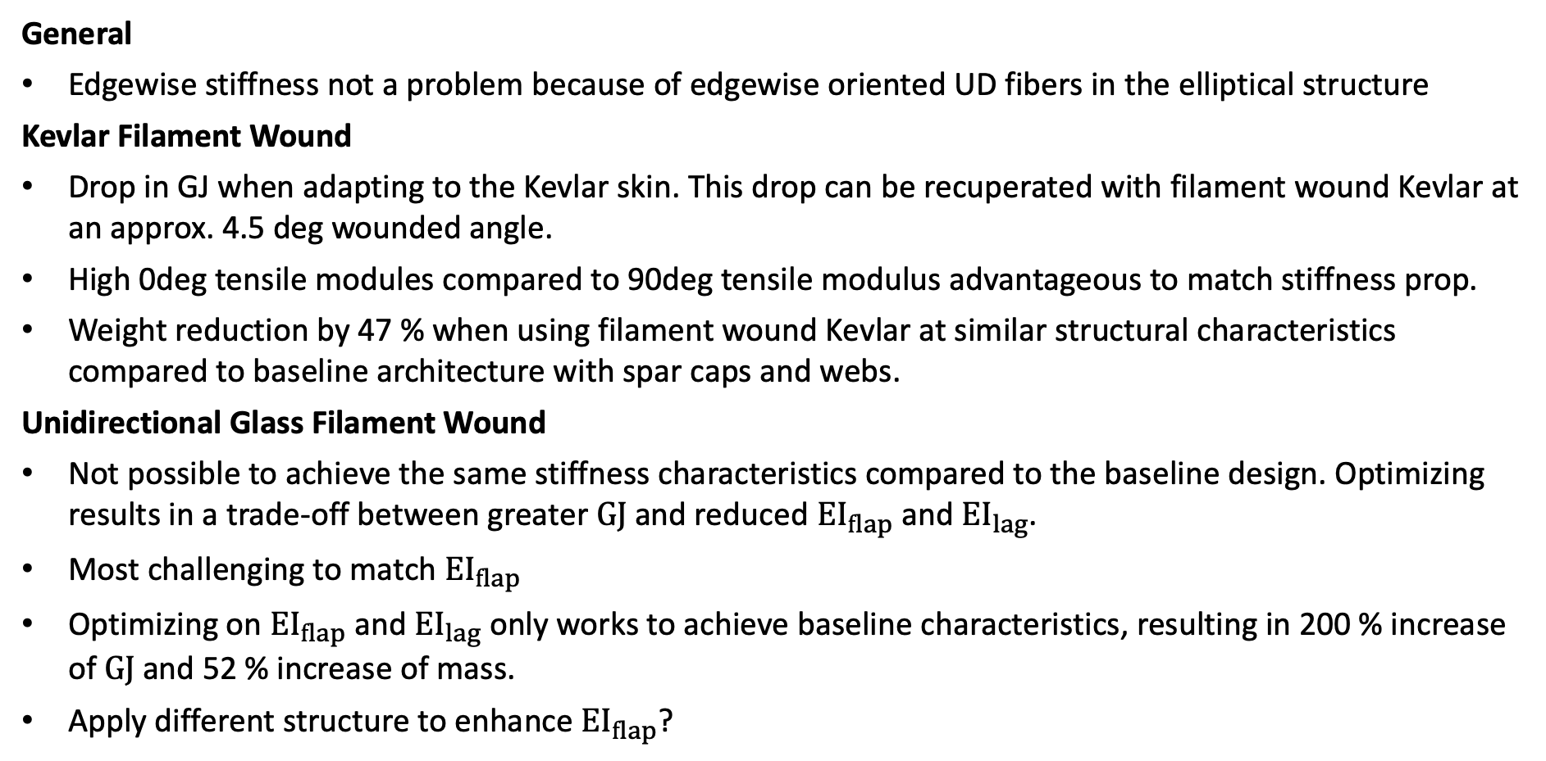
Summary & Conclusions
General
Edgewise stiffness not a problem because of edgewise oriented UD fibers in the elliptical structure
Kevlar Filament Wound
Drop in GJ when adapting to the Kevlar skin. This drop can be recuperated with filament wound Kevlar at an approx. 4.5 deg wounded angle.
High 0deg tensile modules compared to 90deg tensile modulus advantageous to match stiffness prop.
Weight reduction by 47 % when using filament wound Kevlar at similar structural characteristics compared to baseline architecture with spar caps and webs.
Unidirectional Glass Filament Wound
Not possible to achieve the same stiffness characteristics compared to the baseline design. Optimizing results in a trade-off between greater $GJ$ and reduced ${EI}_{flap}$ and ${EI}_{lag}$.
Most challenging to match ${EI}_{flap}$
Optimizing on ${EI}_{flap}$ and ${EI}_{lag}$ only works to achieve baseline characteristics, resulting in 200 % increase of $GJ$ and 52 % increase of mass.
Apply different structure to enhance ${EI}_{flap}$?

Slide 25
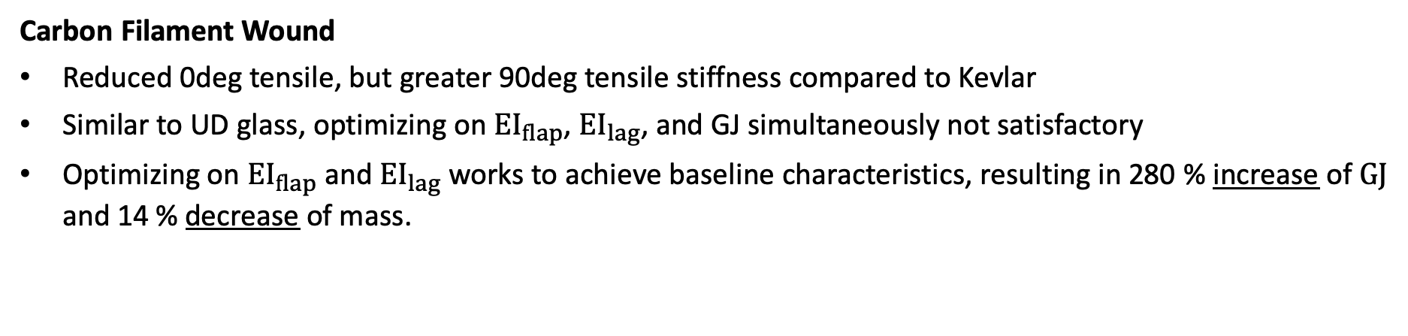
Summary & Conclusions
Carbon Filament Wound
Reduced 0deg tensile, but greater 90deg tensile stiffness compared to Kevlar
Similar to UD glass, optimizing on ${EI}_{flap}$, ${EI}_{lag}$, and GJ simultaneously not satisfactory
Optimizing on ${EI}_{flap}$ and ${EI}_{lag}$ works to achieve baseline characteristics, resulting in 280 % increase of $GJ$ and 14 % decrease of mass.

Slide 26
Outlook, Ongoing Work, and Open Questions
Determine cost model for inflatable blades
fvf for filament wound materials? Reduce/Increase material properties due to different fvf in filament wound primary structure?
(Potentially) exclude the shell and create new baseline from most realistic & promising result based on step 1 studies
(Potentially) add central straight web if insufficient stiffness
How to handle loads’ transmission from shell to primary structure? Add additional supporting structures?
How to preserve airfoil geometric shape with applied loads?
Choose “best” design to extend analysis for the full blade
Evaluate effects such as bend-twist coupling
Evaluate strains (using SONATA/VABS and optionally ANSYS) on both the outer shell and the primary structure
Conduct OpenFAST & BeamDyn simulations to evaluate, performance, (vibratory) loads, and tip deflection characteristics in comparison to baseline blade

Slide 27



Appendix: Coordinate System – SONATA & VABS
Twist is defined along the outer shape ref axis
Ref axis defined with x, y, and z
$$z$$
INPUT EXAMPLE
Outer_shape_bem:
twist:
grid: [0.0, 1.0]
values: [0.2, 0.1]
pitch_axis:
grid: [0.0, 1.0]
values: [0.5, 0.3]
reference_axis:
x:
grid: [0.0, 1.0]
values: [0.0, 50.0]
y:
grid: [0.00, 1.00]
values: [0.0, 0.0]
z:
grid: [0.0, 1.0]
values: [0.0, 0.0]
twist
$$y$$
$$x$$
Pitch axis
Pitch axis defined in relative to chord length, starting at the leading edge

Slide 28
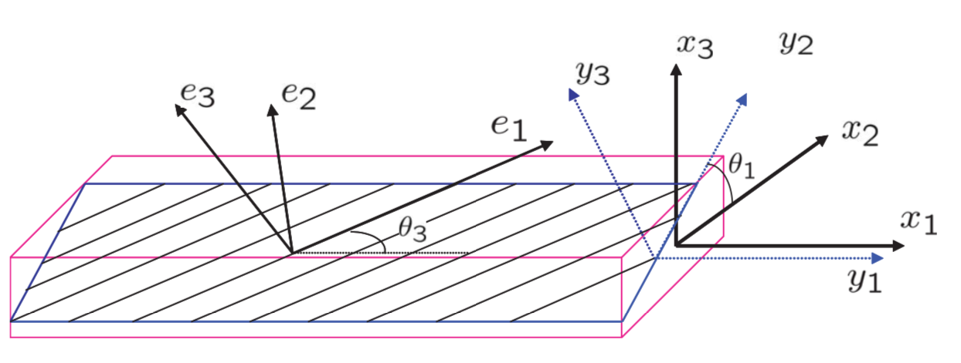
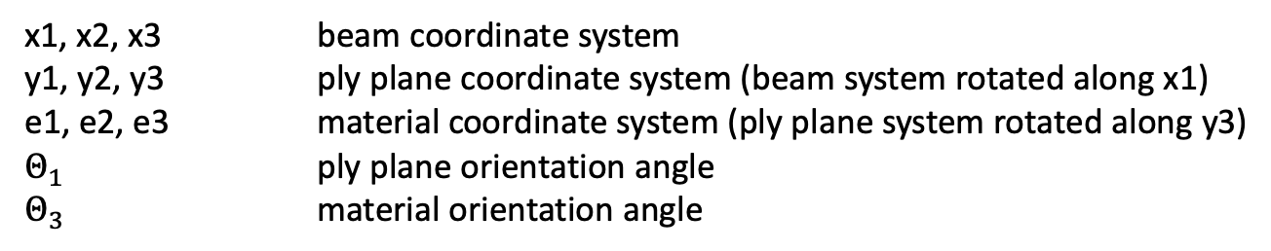
Appendix: Layup Convention – VABS
x1, x2, x3 beam coordinate system
y1, y2, y3 ply plane coordinate system (beam system rotated along x1)
e1, e2, e3 material coordinate system (ply plane system rotated along y3)
$Θ_{1}$ ply plane orientation angle
$Θ_{3}$ material orientation angle

